Slide 1
SORTING

Slide 2
Quick Sort
Quick Sort, as the name suggests, sorts any list very quickly. Quick sort is not stable search, but it is very fast and requires very less aditional space. It is based on the rule of Divide and Conquer(also called partition-exchange sort). This algorithm divides the list into three main parts :
Elements less than the Pivot element
Pivot element
Elements greater than the pivot element

Slide 3
Quick Sort
In the list of elements, 25, 52, 37, 63, 14, 17, 8, 6, we have taken 25 as pivot. So after the first pass, the list will be changed like :
6,8,17,14 ,25,63,37,52
Hnece after the first pass, pivot will be set at its position, with all the elements smaller to it on its left and all the elements larger than it on the right. Now 6,8,17,14 and 63,37,52
are considered as two separate lists, and same logic is applied on them, and we keep doing this until the complete list is sorted.

Slide 4
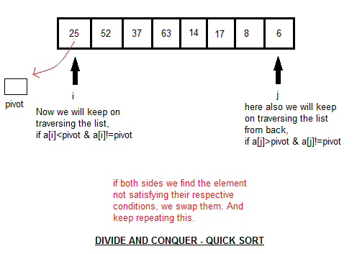
WORKING
CHAPTER 7

Slide 5
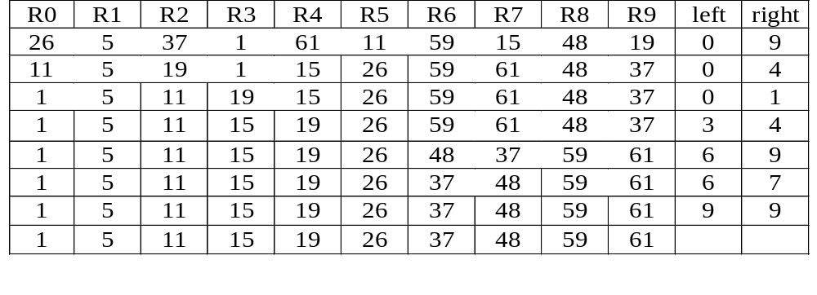
Another Example for Quick Sort
{
}
{
}
{
}
{
}
{
}
{
}
{
}
{
}
{
}
{
}
CHAPTER 7

Slide 6
Quick Sort
void quicksort(element list[], int left, int right)
{
int pivot, i, j;
element temp;
if (left < right) {
i = left; j = right+1;
pivot = list[left].key;
do {
do i++; while (list[i].key < pivot);
do j--; while (list[j].key > pivot);
if (i < j) SWAP(list[i], list[j], temp);
} while (i < j);
SWAP(list[left], list[j], temp);
quicksort(list, left, j-1);
quicksort(list, j+1, right);
}
}
CHAPTER 7

Slide 7
Analysis for Quick Sort
  The worst case O(n²)
Assume that each time a record is positioned, the list is divided into the rough same size of two parts. Positioning within the list with n element needs O(n)
  Assume T(n) is the time taken to sort a list of size n:
T(n)<=cn+2T(n/2) for some c
<=cn+2(cn/2+2T(n/4))
...
<=cnlog n+nT(1)
=O(nlog n)
CHAPTER 7

Slide 8
ANALYSIS OF QUICK SORT
Quick sort needs stack space to implement the recursion.
If the lists split evenly, the maximum recursion depth would be log n and the stack space is of O(log n).
The worst case is when the lists split into a left sublist of size n – 1 and a right sublist of size 0 at each level of recursion. In this case, the recursion depth is n, the stack space of O(n).
The worst case stack space can be reduced by a factor of 4 by realizing that right sublists of size less than 2 need not be stacked. Asymptotic reduction in stack space can be achieved by sorting smaller sublists first. In this case the additional stack space is at most O(log n).

Slide 9
Time and Space for Quick Sort
Space complexity:
  Average case and best case: O(log n)
  Worst case: O(n)
Time complexity:
  Average case and best case: O(n log n)
  Worst case: O(n )
2
CHAPTER 7

Slide 10
MERGE SORT
Given two sorted lists
(A, m)
(B, n)
generate a single sorted list
(C, m+n)
CHAPTER 7

Slide 11
MERGE SORT
The process of merging of two sorted lists into a single sorted list is called simple merge.
CHAPTER 7

Slide 12
EXAMPLE
10 | 20 | 40 | 50 | 15 | 25 | 30 | 10
10 | 20 | 40 | 50 | 15 | 25 | 30 | 10 | 15
10 | 20 | 40 | 50 | 15 | 25 | 30 | 10 | 15 | 20
10 | 20 | 40 | 50 | 15 | 25 | 30 | 10 | 15 | 20 | 25
10 | 20 | 40 | 50 | 15 | 25 | 30 | 10 | 15 | 20 | 25 | 30
10 | 20 | 40 | 50 | 15 | 25 | 30 | 10 | 15 | 20 | 25 | 30 | 40 | 50
10 | 20 | 40 | 50 | 15 | 25 | 30
CHAPTER 7

Slide 13
Merge Sort
void simplemerge(int A[], int B[], int m, int n)
{
int i,j,k;
i=j=k=0;
while (i<m && j<n) {
if (A[i]<B[j])
C[k++]= A[i++];
else
C[k++]= B[j++];
}
while (i<m) C[k++]= A[i++];
while(j<n) C[k++] = B[j++];
}
CHAPTER 7

Slide 14
Recursive Merge Sort
lower
upper
void MergeSort(element list[], int low, int high)
{
int middle;
if (low < high) {
mid = (low+high)/2;
MergeSort(list,low,mid);
MergeSort(list,mid+1,high),
SimpleMerge(list, low, mid, high);
}
}
Point to the start of sorted chain
CHAPTER 7
lower
middle
upper

Slide 15
NATURE MERGE SORT
26 5 77 1 61 11 59 15 48 19
5 26 77
1 11 59 61
15 19 48
1 5 11 26 59 61 77
15 19 48
1 5 11 15 19 26 48 59 61 77
CHAPTER 7

Slide 16
*FIGURE 7.11: ARRAY INTERPRETED AS A BINARY TREE (P.349)
Heap Sort
1 2 3 4 5 6 7 8 9 10
26 5 77 1 61 11 59 15 48 19
input file
[1]
26
[2]
5
[3]
77
[4]
1
[5]
61
[6]
11
[7]
59
[8]
15
[9]
48
[10]
19
CHAPTER 7

Slide 17
*FIGURE 7.12: MAX HEAP FOLLOWING FIRST FOR LOOP OF HEAPSORT(P.350)
initial heap
[1]
77
[2]
61
[3]
59
exchange
[4]
48
[5]
19
[6]
11
[7]
26
[8]
15
[9]
1
[10]
5
CHAPTER 7

Slide 18
FIGURE 7.13: HEAP SORT EXAMPLE(P.351)
[1]
61
[2]
48
[3]
59
15
19
11
[7]
26
[4]
[5]
[6]
[8]
5
[9]
1
[10]
77
(a)
[1]
59
[2]
48
[3]
26
15
19
11
[7]
1
[4]
[5]
[6]
[8]
5
[9]
61
[10]
77
(b)
CHAPTER 7

Slide 19
FIGURE 7.13(CONTINUED): HEAP SORT EXAMPLE(P.351)
[1]
48
[2]
19
[3]
26
15
5
11
[7]
1
[4]
[5]
[6]
59
59
61
[8]
[9]
61
[10]
77
(c)
[1]
26
[2]
19
[3]
11
48
15
5
1
[7]
48
[4]
[5]
[6]
59
[8]
59
[9]
61
[10]
77
(d)
CHAPTER 7

Slide 20
Heap Sort
void adjust(element list[], int root, int n)
{
int child, rootkey; element temp;
temp=list[root]; rootkey=list[root].key;
child=2*root;
while (child <= n) {
if ((child < n) &&
(list[child].key < list[child+1].key))
child++;
if (rootkey > list[child].key) break;
else {
list[child/2] = list[child];
child *= 2;
}
}
list[child/2] = temp;
}
i
2i
2i+1
CHAPTER 7

Slide 21
Heap Sort
void heapsort(element list[], int n)
{
int i, j;
element temp;
for (i=n/2; i>0; i--) adjust(list, i, n);
for (i=n-1; i>0; i--) {
SWAP(list[1], list[i+1], temp);
adjust(list, 1, i);
}
}
ascending order (max heap)
bottom-up
n-1 cylces
top-down
CHAPTER 7

Slide 22
INSERTION SORT
It is a simple Sorting algorithm which sorts the array by shifting elements one by one. Following are some of the important characteristics of Insertion Sort.
It has one of the simplest implementation
It is efficient for smaller data sets, but very inefficient for larger lists.
Insertion Sort is adaptive, that means it reduces its total number of steps if given a partially sorted list, hence it increases its efficiency.

Slide 23
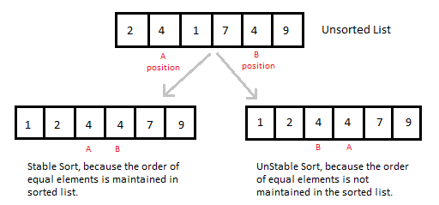
INSERTION SORT CONT….
It is Stable, as it does not change the relative order of elements with equal keys
It is Stable, as it does not change the relative order of elements with equal keys

Slide 24
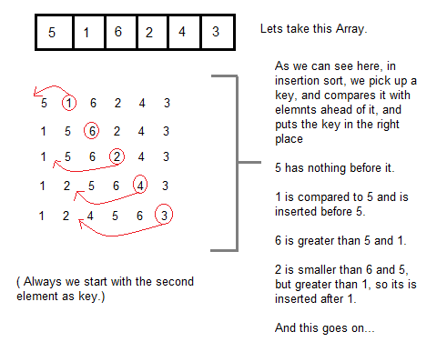
WORKING OF INSERTION SORT
How Insertion Sorting Works

Slide 25
INSERTION SORT
int a[6] = {5, 1, 6, 2, 4, 3};
int i, j, key;
for(i=1; i<6; i++)
{
key = a[i];
j = i-1;
while(j>=0 && key < a[j])
{
a[j+1] = a[j];
j--;
}
a[j+1] = key;
}

